Slide 1
Hypothesis Testing for a Proportion

Slide 2
Hypothesis testing framework
We start with a null hypothesis (H₀) that often represents a skeptical position or a perspective of no difference.
We also have an alternative hypothesis (H_{A}) that represents an alternative claim under consideration and is often represented by a range of possible parameter values.

Slide 3
Recap: hypothesis testing framework
We start with a null hypothesis (H₀) that often represents a skeptical position or a perspective of no difference.
We also have an alternative hypothesis (H_{A}) that represents an alternative claim under consideration and is often represented by a range of possible parameter values.
We conduct a hypothesis test under the assumption that H₀ is true.
If the test results suggest that the data do not provide convincing evidence for the alternative hypothesis, we stick with the null hypothesis. If they do, then we reject the null hypothesis in favor of the alternative.

Slide 4
Testing hypotheses
Earlier we calculated a 95% confidence interval for the proporton of American Facebook users who think Facebook categorizes their interests accurately as 64% to 70%. Based on this confidence interval, do the data support the hypothesis that half of American Facebook users think Facebook categorizes their interests accurately.
H₀: p = 0.50 （50% of American Facebook users think Facebook categorizes their interests accurately） H_{A}: p ≠ 0.50 （Not 50% of American Facebook users think Facebook categorizes their interests accurately）

Slide 5
Decision errors
Hypothesis tests are not flawless.
In the court system innocent people are sometimes wrongly convicted, and the guilty sometimes walk free.
Similarly, we can make a wrong decision in statistical hypothesis tests as well.

Slide 6
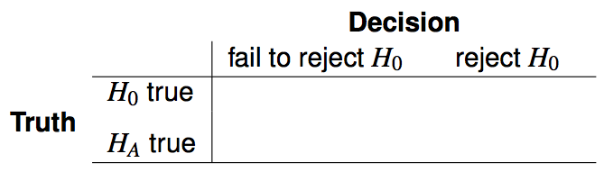
Decision errors (cont.)
There are two competing hypotheses: the null and the alternative. In a hypothesis test, we make a decision about which might be true, but our choice might be incorrect.

Slide 7

Decision errors (cont.)
There are two competing hypotheses: the null and the alternative. In a hypothesis test, we make a decision about which might be true, but our choice might be incorrect.
A Type 1 Error is rejecting the null hypothesis when H₀ is true.

Slide 8

Decision errors (cont.)
There are two competing hypotheses: the null and the alternative. In a hypothesis test, we make a decision about which might be true, but our choice might be incorrect.
A Type 1 Error is rejecting the null hypothesis when H₀ is true.
A Type 2 Error is failing to reject the null hypothesis when H_{A} is true.

Slide 9
Hypothesis Test as a trial
If we again think of a hypothesis test as a criminal trial then it makes sense to frame the verdict in terms of the null and alternative hypotheses:
H₀: Defendant is innocent
H_{A}: Defendant is guilty
Which type of error is being committed in the following circumstances?
Declaring the defendant innocent when they are actually guilty
Declaring the defendant guilty when they are actually innocent

Slide 10
Hypothesis Test as a trial
If we again think of a hypothesis test as a criminal trial then it makes sense to frame the verdict in terms of the null and alternative hypotheses:
H₀: Defendant is innocent
H_{A}: Defendant is guilty
Which type of error is being committed in the following circumstances?
Declaring the defendant innocent when they are actually guilty
Type 2 error
Declaring the defendant guilty when they are actually innocent

Slide 11
Hypothesis Test as a trial
If we again think of a hypothesis test as a criminal trial then it makes sense to frame the verdict in terms of the null and alternative hypotheses:
H₀: Defendant is innocent
H_{A}: Defendant is guilty
Which type of error is being committed in the following circumstances?
Declaring the defendant innocent when they are actually guilty
Type 2 error
Declaring the defendant guilty when they are actually innocent
Type 1 error
Which error do you think is the worse error to make?

Slide 12
Type 1 error rate
P(Type 1 error) = α
Also called Significance level.
α = 0.05 means that, the chance to reject the null hypothesis when H₀ is true is 5%.
α is always predetermined. By default, α = 0.05

Slide 13
Facebook interest categories
The same survey asked the 850 respondents how comfortable they are with Facebook creating a list of categories for them. 41% of the respondents said they are comfortable. Do these data provide convincing evidence that the proportion of American Facebook users are comfortable with Facebook creating a list of interest categories for them is different than 50%?
https://www.pewinternet.org/2019/01/16/facebook-algorithms-and-personal-data/

Slide 14
Facebook interest categories
The same survey asked the 850 respondents how comfortable they are with Facebook creating a list of categories for them. 41% of the respondents said they are comfortable. Do these data provide convincing evidence that the proportion of American Facebook users are comfortable with Facebook creating a list of interest categories for them is different than 50%?
Setting the hypotheses We start with the assumption that 50% of American Facebook users are comfortable with Facebook creating categories of interests for them
H₀: p = 0.50
We test the claim that the proportion of American Facebook users who are comfortable with Facebook creating categories of interests for them is different than 50%.
H_{A}: p ≠ 0.50

Slide 15
Check conditions
Independence?
Sample size?

Slide 16
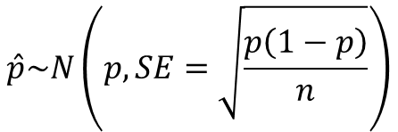
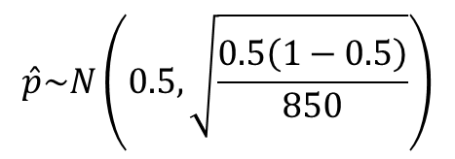
Recall: CLT
$$\hat{p}\sim N\left(p, SE=\sqrt{\frac{p\left(1−p\right)}{n}}\right)$$
H₀: p = 0.50
$$\hat{p}\sim N\left(0.5,\sqrt{\frac{0.5\left(1−0.5\right)}{850}}\right)$$

Slide 17
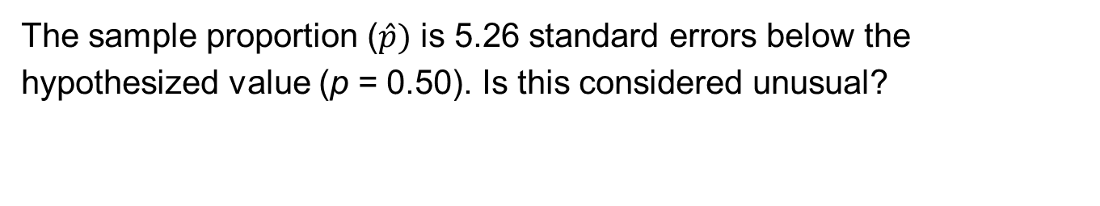
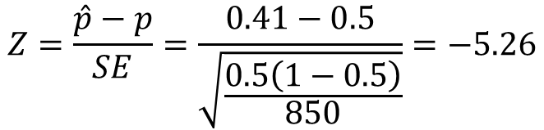
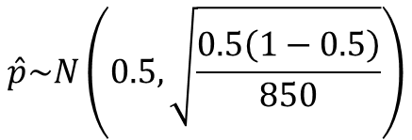
Test statistic
Then, we determine how many standard errors away from the null value it is, which is also called the test statistic.
$$\hat{p}\sim N\left(0.5,\sqrt{\frac{0.5\left(1−0.5\right)}{850}}\right)$$
$$Z=\frac{\hat{p}−p}{SE}=\frac{0.41−0.5}{\sqrt{\frac{0.5\left(1−0.5\right)}{850}}}=−5.26$$
The sample proportion ($\hat{p})$ is 5.26 standard errors below the hypothesized value (p = 0.50). Is this considered unusual?

Slide 18
p-values
The p-value represents the probability of the observed statistic that is equal to the null value or more extreme, if the null hypothesis were true.
If the p-value is low, we say that it would be very unlikely to observe the data if the null hypothesis were true, and hence reject H₀.
If the p-value is high, we say that it is likely to observe the data even if the null hypothesis were true, and hence do not reject H₀.
Caution: We never say we accept Ho!

Slide 19
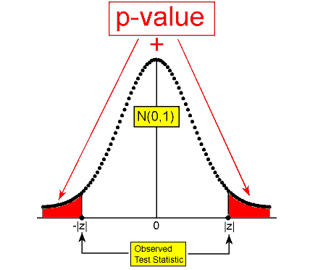
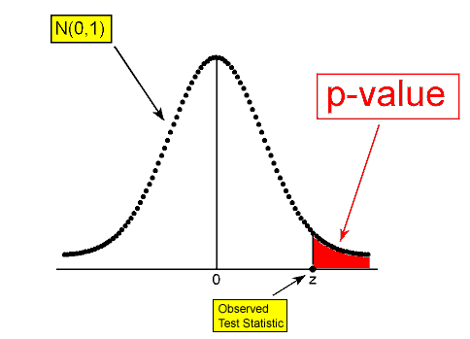
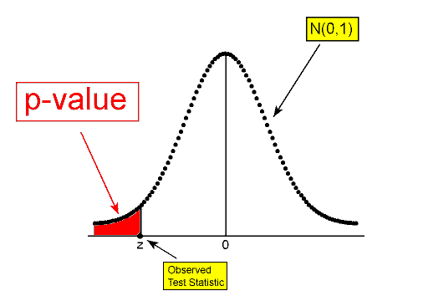
p-value and H_{A}

Slide 20
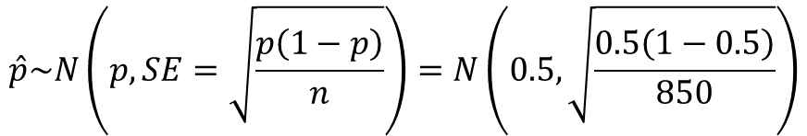
P-value
In order to evaluate if the observed sample statistic is unusual under the null hypothysis, we determine how many standard errors away from the null value it is, which is also called the test statistic.
$$\hat{p}\sim N\left(p, SE=\sqrt{\frac{p\left(1−p\right)}{n}}\right)=N\left(0.5,\sqrt{\frac{0.5\left(1−0.5\right)}{850}}\right)$$
$$Z=\frac{\hat{p}−p}{SE}=\frac{0.41−0.5}{\sqrt{\frac{0.5\left(1−0.5\right)}{850}}}=−5.26$$
Find the p-value and make a conclusion.

Slide 21
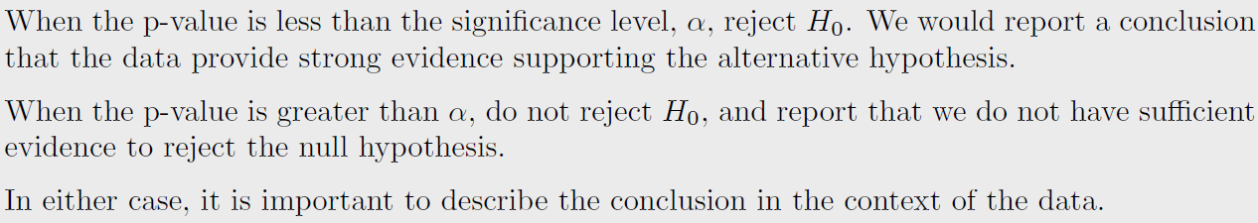

p-value and $α$

Slide 22
Testing hypotheses using confidence intervals
Earlier we calculated a 95% confidence interval for the proporton of American Facebook users who think Facebook categorizes their interests accurately as 64% to 70%. Based on this confidence interval, do the data support the hypothesis that half of American Facebook users think Facebook categorizes their interests accurately.
H₀: p = 0.50: 50% of American Facebook users think Facebook categorizes their interests accurately H_{A}: p ≠ 0.50: Not 50% of American Facebook users think Facebook categorizes their interests accurately
Null value (0.50) is not included in the 95% confidence interval for p
→ reject the null hypothesis.
This is a quick-and-dirty approach for hypothesis testing with “≠” sign in H_{A}.

Slide 23
Hypothesis Testing for a Mean

Slide 24
Testing hypotheses using confidence intervals
Earlier we calculated a 95% confidence interval for the average number of exclusive relationships college students have been in to be (2.7, 3.7). Based on this confidence interval, do these data support the hypothesis that college students on average have been in 3 exclusive relationships.

Slide 25
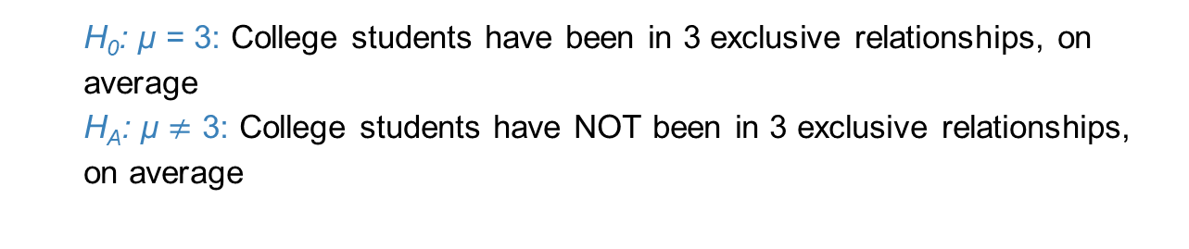
Testing hypotheses using confidence intervals
Earlier we calculated a 95% confidence interval for the average number of exclusive relationships college students have been in to be (2.7, 3.7). Based on this confidence interval, do these data support the hypothesis that college students on average have been in 3 exclusive relationships.
H₀: µ = 3: College students have been in 3 exclusive relationships, on average
H_{A}: µ $≠$ 3: College students have NOT been in 3 exclusive relationships, on average
This is a quick-and-dirty approach for the two-sided hypothesis testing.

Slide 26
Number of college applications
A similar survey asked how many colleges students applied to, and 206 students responded to this question. This sample yielded an average of 9.7 college applications. Assume that the standard deviation of the number of college applications was 7. College Board website states that counselors recommend students apply to roughly 8 colleges.
Do the survey data provide convincing evidence that the average number of colleges all Duke students apply to is higher than recommended?

Slide 27
Setting the hypotheses
We start with the assumption the average number of colleges Duke students apply to is 8 (as recommended)
H₀ : 𝝁 = 8
We test the claim that the average number of colleges Duke students apply to is higher than 8
H_{A} : 𝝁 > 8

Slide 28
Check conditions
Independence?
Sample size / Normality?

Slide 29
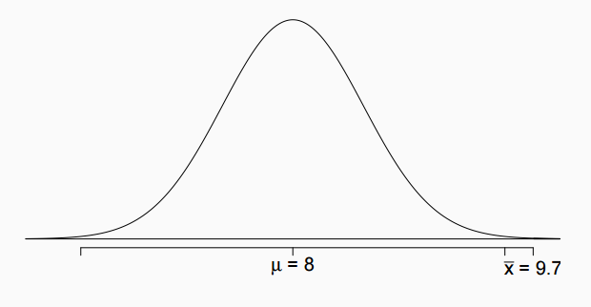
Test Statistic
In order to evaluate if the observed sample mean is unusual under the null, we determine how many standard errors away from the null it is, which is also called the test statistic.

Slide 30
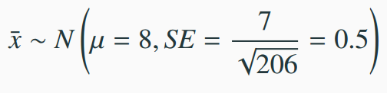
Test Statistic
In order to evaluate if the observed sample mean is unusual for the hypothesized sampling distribution, we determine how many standard errors away from the null it is, which is also called the test statistic.

Slide 31

Test Statistic
In order to evaluate if the observed sample mean is unusual for the hypothesized sampling distribution, we determine how many standard errors away from the null it is, which is also called the test statistic.
$$Z=\frac{\overline{x}−μ}{SE}=\frac{9.7−8}{0.5}=3.4$$

Slide 32
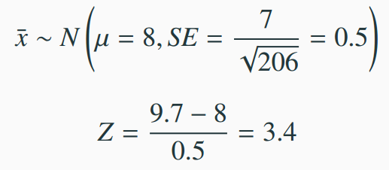
Test Statistic
In order to evaluate if the observed sample mean is unusual for the hypothesized sampling distribution, we determine how many standard errors away from the null it is, which is also called the test statistic.
The sample mean is 3.4 standard errors away from the hypothesized value.
Is this considered unusual?

Slide 33
Test Statistic
In order to evaluate if the observed sample mean is unusual for the hypothesized sampling distribution, we determine how many standard errors away from the null it is, which is also called the test statistic.
The sample mean is 3.4 standard errors away from the hypothesized value.
P-value = P(Z > 3.4) = 0.0003

Slide 34
Number of college applications - Making a decision
p-value = 0.0003
If the true average of the number of colleges Duke students applied to is 8, there is only 0.03% chance of observing a random sample of 206 Duke students who on average apply to 9.7 or more schools.

Slide 35
Number of college applications - Making a decision
p-value = 0.0003
If the true average of the number of colleges Duke students applied to is 8, there is only 0.03% chance of observing a random sample of 206 Duke students who on average apply to 9.7 or more schools.
This is a pretty low probability for us to think that a sample mean of 9.7 or more schools is likely to happen simply by chance.

Slide 36
Number of college applications - Making a decision
p-value = 0.0003
If the true average of the number of colleges Duke students applied to is 8, there is only 0.03% chance of observing a random sample of 206 Duke students who on average apply to 9.7 or more schools.
This is a pretty low probability for us to think that a sample mean of 9.7 or more schools is likely to happen simply by chance.
Using α=0.05, since p-value < α, we reject H₀.
The data provide convincing evidence that Duke students apply to more than 8 schools on average.

Slide 37
Practice
A poll by the National Sleep Foundation found that college students average about 7 hours of sleep per night. A random sample of 169 college students yielded an average of 6.88 hours. Assume the standard deviation of sleep hours is 0.94 hours. A hypothesis test was conducted to evaluate if college students on average sleep less than 7 hours per night. The p-value for this hypothesis test is 0.0485. Which of the following is correct?
Fail to reject H₀, the data provide convincing evidence that college students sleep less than 7 hours on average.
Reject H₀, the data provide convincing evidence that college students sleep less than 7 hours on average.
Reject H₀, the data prove that college students sleep more than 7 hours on average.
Fail to reject H₀, the data do not provide convincing evidence that college students sleep less than 7 hours on average.

Slide 38
Practice
A poll by the National Sleep Foundation found that college students average about 7 hours of sleep per night. A random sample of 169 college students yielded an average of 6.88 hours. Assume the standard deviation of sleep hours is 0.94 hours. A hypothesis test was conducted to evaluate if college students on average sleep less than 7 hours per night. The p-value for this hypothesis test is 0.0485. Which of the following is correct?
Fail to reject H₀, the data provide convincing evidence that college students sleep less than 7 hours on average.
Reject H₀, the data provide convincing evidence that college students sleep less than 7 hours on average.
Reject H₀, the data prove that college students sleep more than 7 hours on average.
Fail to reject H₀, the data do not provide convincing evidence that college students sleep less than 7 hours on average.

Slide 39
Two-sided hypothesis testing with p-values
If the research question was “Do the data provide convincing evidence that the average amount of sleep college students get per night is different than the national average?”, the alternative hypothesis would be different
H₀: µ = 7
H_{A}: µ ≠ 7

Slide 40
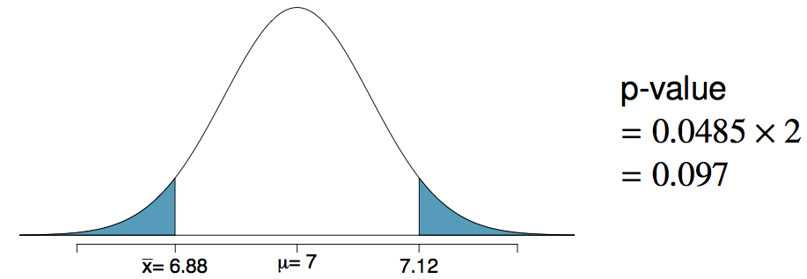
Two-sided hypothesis testing with p-values
If the research question was “Do the data provide convincing evidence that the average amount of sleep college students get per night is different than the national average?”, the alternative hypothesis would be different
H₀: µ = 7
H_{A}: µ ≠ 7
Hence the p-value would change as well:

Slide 41
Recap: Hypothesis testing framework
Set the hypotheses and check conditions.
Calculate a test statistic
Find the p-value.
Make a decision, and interpret it in context of the research question.

